Slide 1
Measuring the Cyclically Adjusted and
Structural Balances in Trinidad and Tobago
5th Biennial International
Business, Banking and Finance Conference
University of the West Indies, St. Augustine Campus.
Presenter: Joseph Jason Cotton
May 3rd, 2013

Slide 2
Outline
Background
Methodology
Results
Conclusions

Slide 3
Background
Main Concepts | What does it tell us? | How is it measured?
Overall Fiscal Balance | Provides an indication of the impact of fiscal policy on domestic demand and financial resources. | Overall Fiscal Balance =TR-TE
Fiscal impulse | Provides an indication as to whether fiscal policy is becoming more or less expansionary over time. | Measured as the change in the structural balance
Expansionary Fiscal Policy | An increase in government expenditures and/or a decrease in taxes that causes the government's budget deficit to increase or its budget surplus to decrease. | Measured as the change in the overall fiscal balance or primary balance.
Contractionary Fiscal Policy | A decrease in government expenditures and/or an increase in taxes that causes the government's budget deficit to decrease or its budget surplus to increase. | Measured as the change in the overall fiscal balance or primary balance.

Slide 4
Background Cont’d
Main Concepts | What does it tell us? | How is it measured?
Cyclical Adjustment | It removes the cyclical component of a time series and provides a sense of the underlying movements in a time series. | The Hodrick-Prescott (HP) Filter
Structural Adjustment | Goes beyond the cyclical adjustment and corrects for changes in asset or commodity prices which do not affect the underlying fiscal position | Structurally adjusted balance
Countercyclical | Adding to aggregate demand during downturns (through deficits) and withdrawing from aggregate demand during upturns (through surpluses) | It is measured by the fiscal impulse
Pro cyclical | Adding to aggregate demand during upturns (through deficits) and withdrawing from aggregate demand during downturns (through surpluses). | It is measured by the fiscal impulse

Slide 5
Background Cont’d
Austerity vs Stimulus: Measurement Indicators
The overall fiscal balance
The primary fiscal balance
The cyclical fiscal balance
The structural fiscal balance
Conventional
New

Slide 6
Background Cont’d
The fiscal impulse was mostly positive during 2002-2008 and negative during 2009-2011.
This suggests a countercyclical response to the economic cycle.
This type of assessment can be misleading because it does not adjust for the impact of the business cycle and/or commodity price fluctuations on the budget.

Slide 7
Background Cont’d
Fiscal Indicator | What does it tell us? | How is it measured? | Strength | Weaknesses
The cyclical fiscal balance | Provides a measure of the country’s underlying fiscal position. | CAB= OB -CB | Eliminates the impact of the business cycle on the budget. | May not detect the impact of a commodity price boom.
The structural fiscal balance | Provides a measure of the country’s underlying fiscal position excluding commodity related revenue and expenditure. | SB= OB-SB | Eliminates the impact of the business cycle and changes in asset or commodity prices. | Some level of subjectivity required in adjustment of revenue and expenditure.

Slide 8
Background Cont’d
Usefulness of estimating the cyclical and structural fiscal balances:
They provide a more accurate indication of the budget impact on the economy.
Allows for improved formulation of medium-term fiscal frameworks.
Practical for international comparisons.
Changes in the structural balance can indicate the impact of discretionary fiscal policy on the economy.

Slide 9
Methodology
The two main methods of calculating the cyclical and structural balances were put forward by:
The International Monetary Fund (IMF)
The Organization for Economic Co-operation and Development (OECD)

Slide 10
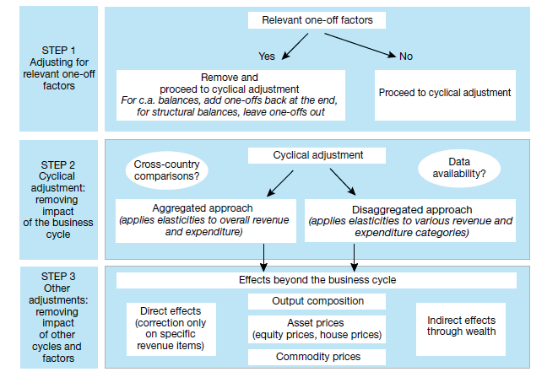
IMF Methodology

Slide 11
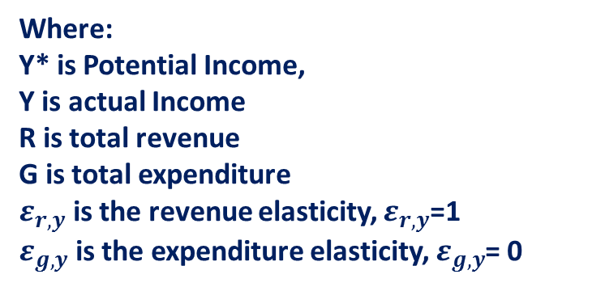
Methodology Cont’d
Notes:
Notes:
The IMF methodology distinguishes between a cyclical balance and a cyclically adjusted balance.
This cyclical adjustment removes the impact of the business cycle effects from the fiscal balance and provides an estimate of the fiscal position net of cyclical effects. The cyclical adjusted balance (CAB) is computed as cyclically adjusted overall revenue ($R^{CA}$ ) minus cyclically adjusted expenditure ($G^{CA}$ ).
$R^{CA}$ is the cyclically adjusted overall revenue which can be obtained by adjusting the actual revenues for the effects of the deviation of potential output from actual output.
$ε_{r,y}$ is the revenue elasticity which defines the strength of the cyclical effect.
$G^{CA}$ is the cyclically adjusted expenditure, however this is equal to actual expenditure, under the assumption of zero expenditure elasticity.
$ε_{g,y}$ is the elasticity of expenditure, which the IMF assumes to be zero since all expenditure is viewed as discretionary and hence independent of the business cycle.
One advantage of this approach: is computationally simpler as elasticities of revenue and expenditure are either assumed to be 1 and 0 respectively. They can also be sourced from existing studies or via regression analysis on aggregate levels of revenue and expenditure
Limitations: The elasticity of tax revenue with respect to output is not unity in most countries.

Slide 12
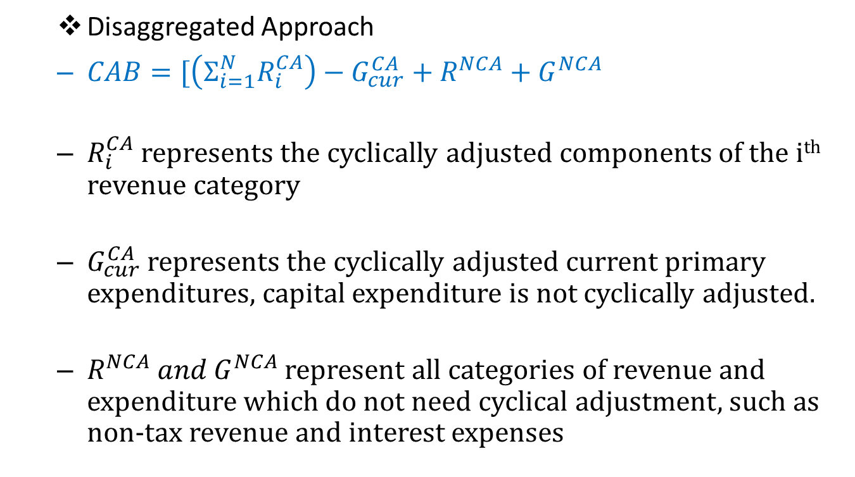
Methodology Cont’d

Slide 13
Methodology Cont’d
Revenue is adjusted for output and commodity price gaps.
Where
$\left[\frac{C∗}{C}\right] ^{E r\text{,}\text{a} }$adjusts revenue for the deviation of commodity prices from and average commodity price index.
$E r\text{,}\text{c}$ – once this is > 0. Deviations in commodity prices will affect the structural balance

Slide 14
Methodology Cont’d

Slide 15
Methodology Cont’d
The IMF methodology draws on arithmetic formulas to assess the budget’s impact on aggregate demand and involves three conceptual issues:
The choice of the base year
Deriving the Cyclical fiscal balance
Deriving the Structural fiscal balance

Slide 16
Methodology Cont’d
Deriving the Cyclical fiscal balance involves:
Data gathering
Identifying relevant one-off factors
Remove one-off factors from data
Adjust for cyclical factors
Add back one-off factors

Slide 17
Methodology Cont’d
Deriving the Structural fiscal balance involves:
Data gathering
Identifying relevant one-off factors
Remove one-off factors from data
Remove energy related revenue and expenditure
Compute the asset price adjustment
Adjust for cyclical factors

Slide 18
Methodology Cont’d
Limitations:
The Output gap and elasticities’ of revenue and expenditure were estimated.
Subjectivity in determining one-off factors.
No adjustment was made for changes in property prices.
ECPI data only available from 2004.
Notes:
Notes:

Slide 19
Results
…the effect of the business cycle on revenue and expenditure did not appear to significantly distort the fiscal analysis during the review period.

Slide 20
Results Cont’d
…the graph shows that the CAB displayed more volatility than the SFB during the review period.

Slide 21
Results Cont’d
…fiscal policy is predominantly pro cyclical in Trinidad and Tobago.

Slide 22
Results Cont’d
…as the economy attempts to return to a path of sustainable economic growth, particularly in the non-energy sector, governments’ active participation will be critical.
Notes:
Notes:
Additionally, graph 6 shows that changes in the non-energy sector almost mirror movements in the government’s fiscal impulse. Therefore, as the economy attempts to return to a path of sustainable economic growth, particularly in the non-energy sector, governments’ active participation will be critical. The State is the largest purchaser of goods and services in the economy and plays a crucial part in engendering private sector confidence through its own spending programme. Based on the analysis, the recovery of the non-energy sector in the short to medium term can be jeopardized without the necessary fiscal support. However, in adopting an appropriate fiscal stimulus, the government has to strike a delicate balance between fostering economic growth and containing potential inflationary pressures, while ensuring that the fiscal outturn is sustainable. The latter is very important, as persistent fiscal deficits can translate into higher debt levels and debt servicing costs.

Slide 23
Results Cont’d
…during the pre-crisis years (2003-2008) the energy sector provided most of the impetus for changes in aggregate demand. However, there have also been signs of an improved fiscal impulse from the non-energy sector since the year 2009.

Slide 24
Conclusions
The fiscal impulse was much stronger in the pre-crisis period (2003-2008) than the post crisis period (2009-2011).
Fiscal policy is predominantly pro-cyclical in Trinidad and Tobago.
The effect of the business cycle on revenue and expenditure did not significantly distort the fiscal outturn during the review period.

Slide 25
Conclusions Cont’d
In resource dependent economies like Trinidad and Tobago it may be useful to estimate the structural fiscal balance to get a clearer picture of the underlying fiscal position and the effect of fiscal policy on aggregate demand.
The energy sector provides most of the impetus for changes in aggregate demand. However, there have also been signs of an improved fiscal impulse from the non-energy sector since 2009.
As the economy attempts to return to a path of sustainable economic growth, particularly in the non-energy sector, governments’ active participation will be critical.
Notes:
4. “resource dependent” - also known as rentier economies

Slide 26
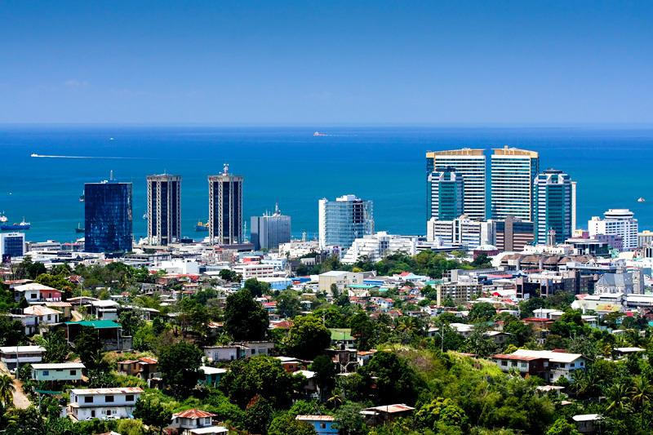
Thank you for your attention.
Please feel free to e-mail your comments to
jcotton@central-bank.org.tt . This paper can be
accessed on the website of the Central Bank of
Trinidad and Tobago. See WP12/2013 April 2013.

